Slide 1

Seasonal Agriculture Performance Analysis
GURU PRASAD K S
KPR INSTITUTE OF ENGINNERING AND TECHNOLOGY
AICTE STU ID : STU6a4b2310c87b31783309072

Slide 2

PROBLEM STATEMENT
Agricultural activities are influenced by seasonal variations in environmental conditions, farming practices, resource availability and market conditions. As a result, agricultural performance may differ from one season to another. However, raw agricultural data does not clearly explain how agricultural performance changes across seasons or what patterns can be observed in different seasonal conditions. The problem is to analyze the given agricultural dataset and investigate seasonal differences in agricultural performance by identifying meaningful patterns, trends, relationships and variations within the available data.

Slide 3
Project Description Agricultural performance is affected by seasonal changes in environmental conditions, farming practices, irrigation methods, resource usage, and market conditions. These factors can influence crop yield, production, water efficiency, revenue, and profit. However, it is difficult to understand these variations directly from raw agricultural data. Therefore, this project analyzes the agricultural dataset to compare performance across different seasons and identify important patterns, relationships, and factors affecting agricultural productivity and profitability.

Slide 4

WHO ARE THE END USERS?
The main end users of this project are:
Farmers – To understand crop performance and improve farming decisions.
Agricultural Officers – To monitor seasonal agricultural performance and provide guidance.
Agricultural Researchers – To study trends and relationships in agricultural data.
Government Departments – To support agricultural planning and policy decisions.
Agribusiness Companies – To understand crop production, profitability, and resource usage.

Slide 5

Technology Used
Python – Programming language used for data analysis.
Google Colab – Platform used to write and execute Python code.
Pandas – Data cleaning and data manipulation.
NumPy – Numerical calculations.
Matplotlib – Data visualization.
Seaborn – Statistical graphs and visualizations.
SciPy – Statistical analysis and ANOVA testing.
CSV Dataset – Used as the main agricultural data source.

Slide 6
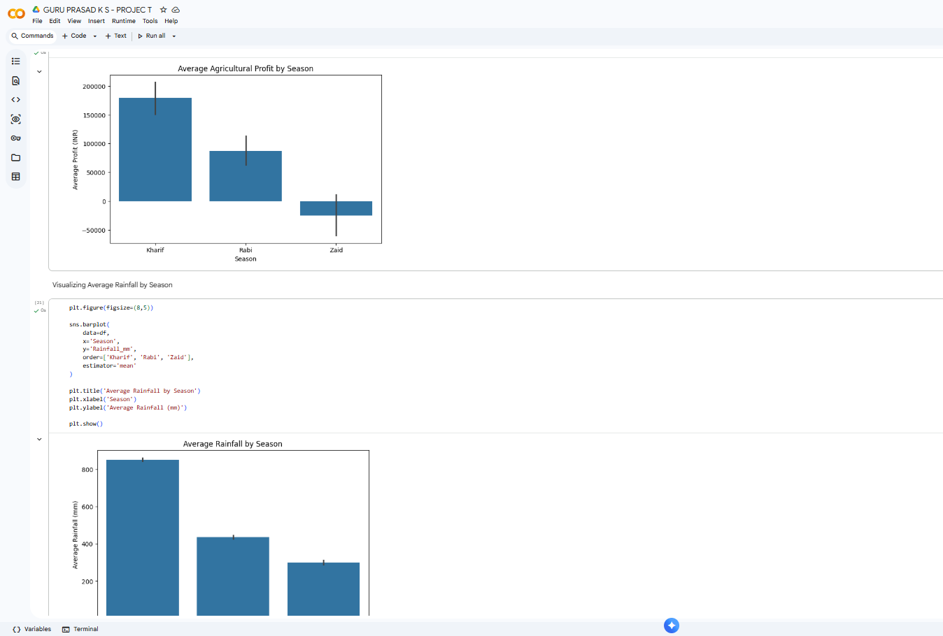
RESULTS

Slide 7
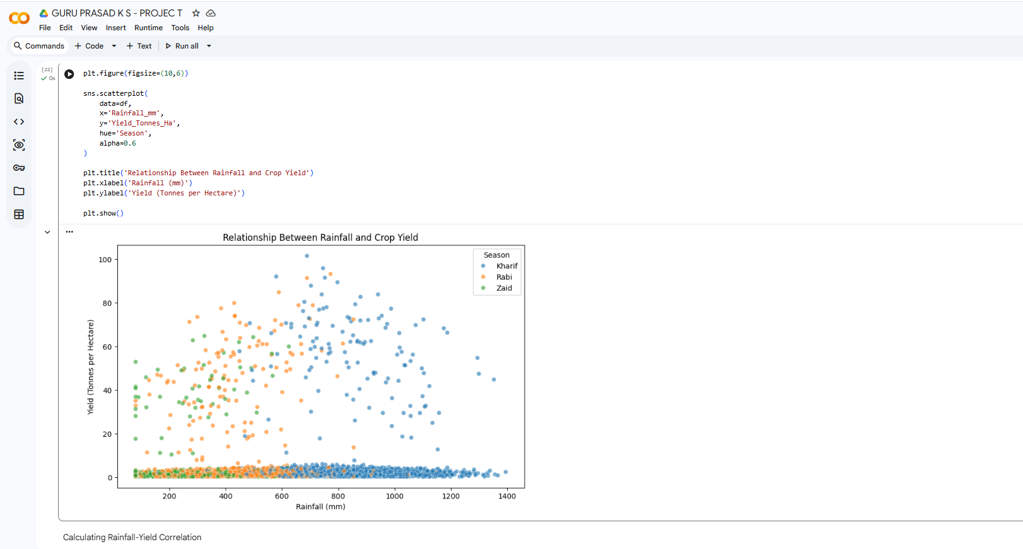
RESULTS
[Add screen shots of your code ]

Slide 8
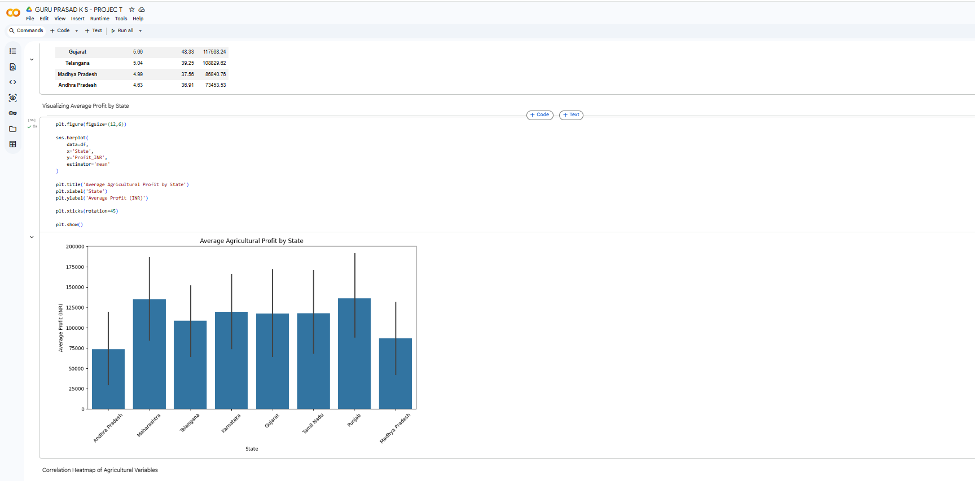
RESULTS
[Add screen shots of your code ]

Slide 9
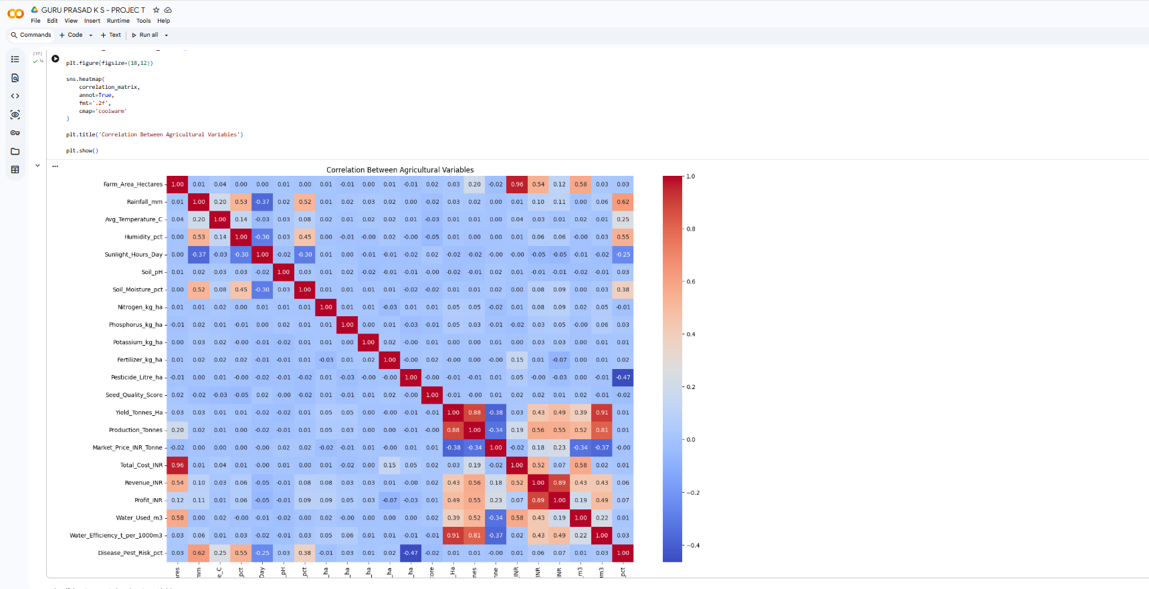
RESULTS
[Add screen shots of your code ]

Slide 10
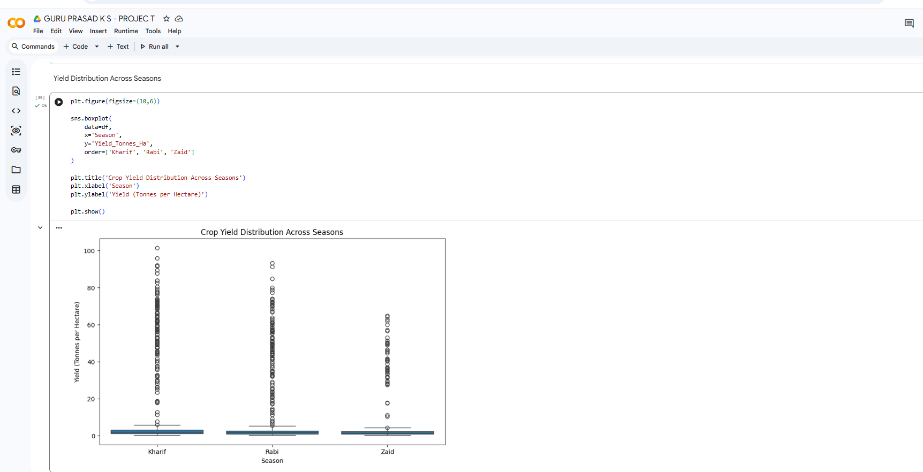
RESULTS
[Add screen shots of your code ]

Slide 11
Future scope
In the future, this project can be improved by using machine learning models to predict crop yield and profit. Real-time weather and soil data can be included for better predictions. A farmer-friendly dashboard or mobile application can also be developed to provide recommendations on irrigation, fertilizers, pest control, and suitable crops. The system can further be expanded to support real-time monitoring and smart farming decisions

Slide 12
GitHub Link
https://github.com/guruprasad172007/Seasonal-Agriculture-Performance-Analysis.git

Slide 13
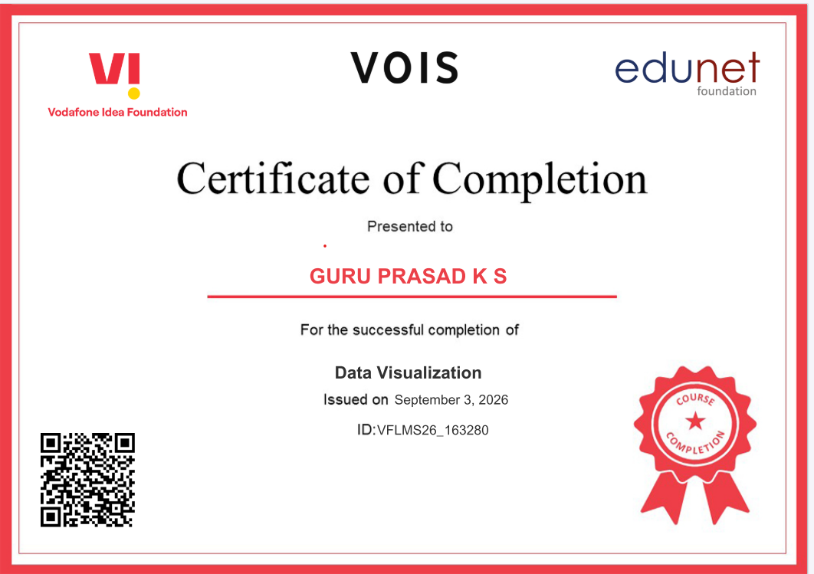
VOIS Course completion certificate - Course name- Data Visualization

Slide 14
Thank you
.
.

